Slide 1
Implementation and characterization of an open-source plasma plume code
FINAL DEGREE DISSERTATION
Pablo Moreno de Santos
Tutor: Mario Merino Martinez
Degree in Aerospace engineering

Slide 2
INDEX
INTRODUCTION AND MOTIVATION …………………………………….. 3
FAR-REGION MODELLING OF PLUME EXPANSION ………………… 7
ASYMPTOTIC EXPANSION METHOD ……………………………………. 8
SELF-SIMILAR METHOD ……………………………………………………... 11
HYPERPLUME PYTHON CODE ……………………………………………. 13
CHARACTERIZATION OF FAR-REGION PLUMES WITH HYPERPLUME …………………..……………………………………………… 16
CONCLUSIONS …………………………………………………………………. 24
REFERENCES …………………………………………………………………….. 25

Slide 3
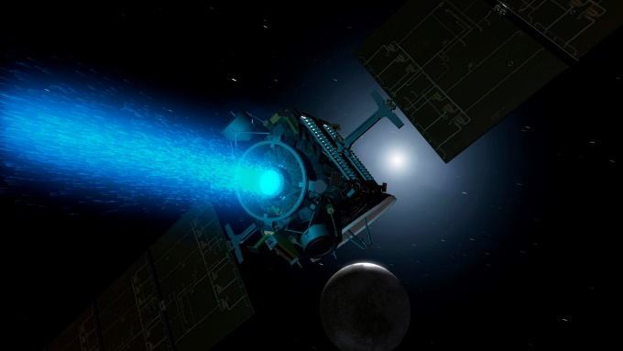
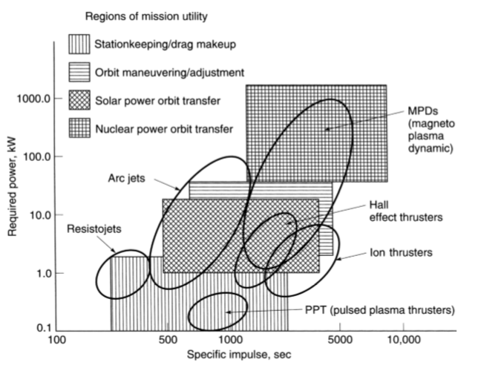
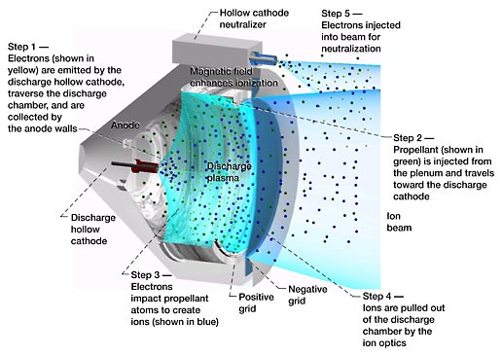
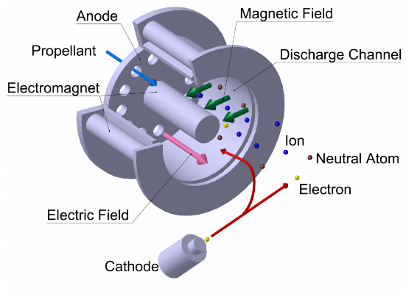

INTRODUCTION AND MOTIVATION
Electric Propulsion vs. Chemical Propulsion: higher Specific Impulse and lower Thrust.
$F=\dot{m}v_{2}=\dot{m}g_{0}I_{sp}$ $I_{sp}= \frac{\int_{0}^{t}{Fdt }}{g_{0}\int_{0}^{t}{mdt}}$
Electric propulsion ideal for GEO and LEO satellite operations (orbit transfers) as well as deep-space applications.
Active areas of investigation in EP: Incremental technologies – Study of exhaust plasma plume expansion outside GIT and HET
Satellite propelled with plasma drive
Areas of application of various
Electric propulsion systems
GRIDDED ION THRUSTER
HALL EFFECT THRUSTER

Slide 4
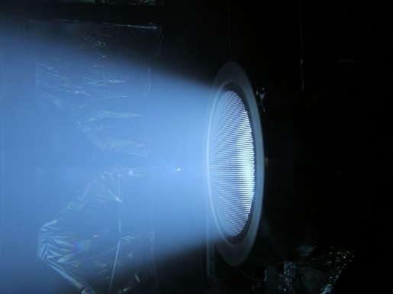
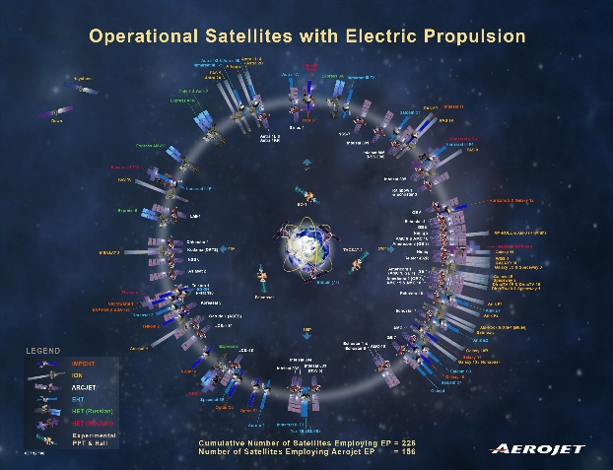
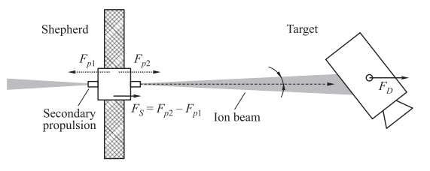
INTRODUCTION AND MOTIVATION
Plasma plumes: Ionized gas propellant expelled from electric thrusters at high divergence angles.
Potential Problems: big concern for spacecraft integrators due to the loss of propulsive momentum and plasma-spacecraft interaction (sputtering, arc discharges,…) of plumes.
Innovative Applications: Using plasma plumes for Space debris removal.
DEPICTION OF A PLASMA PLUME
SATELLITES USING ELECTRIC PROPULSION
ION BEAM SHEPHERD CONCEPT

Slide 5
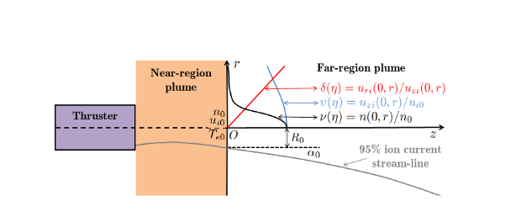
INTRODUCTION AND MOTIVATION
Limited availability of space in-flight data and lab measurement impediments -> Plume modeling.
Near-Region and Far-Region plume expansion modelling.
Near-Region plume expansion: more complex, advance models are needed (PIC)
Far-Region plume expansion: 0.6 – 1 m. out of thruster. Simpler, colisionless and non-magnetic. (Semi-analytical models can be used)
Previous investigations on simple Far-Region plasma plume models were presented in [2]. This dissertation builds upon that work.
Description of plume regions: Near region vs. far-region

Slide 6
INTRODUCTION AND MOTIVATION
Objectives of this dissertation:
Understand and model the physical equations driving a two-fluid, colisionless, and unmagnetized far-region plume expansion.
Inspect two semi-analytical methods in far-region hypersonic plume expansion characterization: the Self-Similar Method (SSM) and the Asymptotic Expansion Method (AEM).
Development of HyperPlume, an Open-Source code written in Python to implement and characterise far-region plume expansions within SSM and AEM theory frameworks.
Inspect the results obtained from HyperPlume and compare them against previous far-region plume expansions codes to check the validity of the Open-Source code.

Slide 7
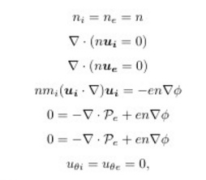
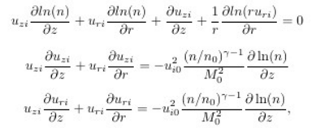
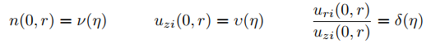

FAR-REGION MODELLING OF PLUME EXPANSION
Far-region plume steady-state two-fluid model equations:
Assumptions
Assumptions: $L≫ λ_{D}$, quasineutral and unmagnetized plume expansion, $P_{e}$ approximated to isotropic tensor, neglect ion thermal pressure and electron inertia…
Hyperbolic Equations: Important parameter is $M_{0}$. Solved under two semi-analytical methods valid for hypersonic plume expansions ($M_{0}≫1$ ): AEM and SSM.
Hyperbolic plume expansion equations in
radial cords. After assumptions
General two-fluid equations
Initial plume profiles (boundary conditions)
Defined at initial far-region plume plane O

Slide 8
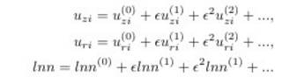
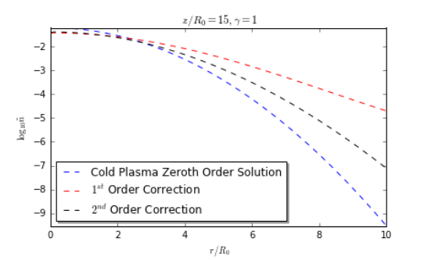
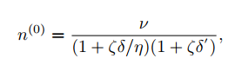
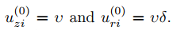

ASYMPTOTIC EXPANSION METHOD
AEM based on perturbation theory and asymptotic expansions about $ε=\frac{1}{M_{0}^{2}}≪1.$ General solution built upon AEM higher order corrections.
Change of reference system, from $\left(z,r\right)$ map to $\left(η,ζ\right),$ returns simpler equations:
General aem solution: unperturbed term + arbitrarily
Higher order corrections
Zeroth order aem equationS
density comparison (logarithm) between aem zeroth, 1st and 2nd order solutions.

Slide 9
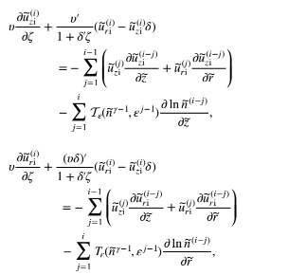
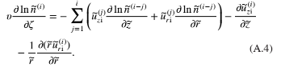

ASYMPTOTIC EXPANSION METHOD
AEM advantages: perturbation terms independent of $M_{0}$ (quick parametric studies), more flexibility in the choice of initial density and velocity profiles.
AEM disadvantages: narrow convergence zone, accuracy depends on higher order corrections (more complex equations).
Improvement: AEM with marching scheme.
AEM HIGHER ORDERCORRECTION GENERAL EQUATIONS.

Slide 10

ASYMPTOTIC EXPANSION METHOD
AEM re-initialization or marching scheme: AEM integration split into steps or plume fronts. At every plume axial step $z^{j}=const:$
Step plasma plume profiles (density, axial and radial velocity, etc.) are used as initial conditions for following steps .
Advantages: No more additional higher order corrections. Increase in accuracy, wider convergence region.
PLASMA PLUME PROPPERTIES AT SPECIFIC Z=CONST
FRONTS ARE FUNCTIONS OF THE RADIAL DISTANCE.
AEM MARCHING INTEGRATION PROCEDURE: REINITIALIZTION OF
PLASMA PLUME PARAMETERS UPDATING PREVIOS STEP.

Slide 11
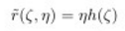
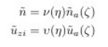
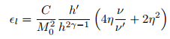
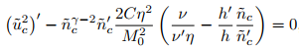

SELF-SIMILARITY METHOD
SSM based on self-similarity of plume expansions: typically smooth, bell-shaped radial plasma profile, invariable along the axial direction with radial broadening.
Very accurate for hypersonic expansions. SSM error proportional to $1/M_{0}^{2}$.
Simpler, but more restrictive than AEM due to model constraints.
SSM EQUATIONS AFTER CONSTANT
AXIAL VELOCITY ALONG CENTRELINE
ASSUMPTIO.
GENERAL SSM EQUATIONS.

Slide 12
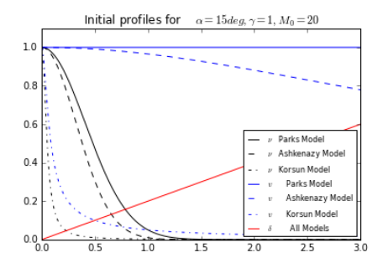
SELF-SIMILARITY METHOD
SSM advantages: algebraically simpler and more accurate than AEM in a wider region; provides important parameters with no need of further processing (ion streamlines).
SSM disadvantages: limited range of initial plasma profiles can be explored accurately.
Ssm INITIAL PROFILES PROPOSED BY PARKS, KORSUN AND
ASHKENAZY FOR ACCURATE SSM RESULTS.

Slide 13

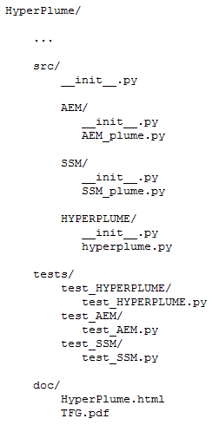
HYPERPLUME PYTHON CODE
How to implement SSM and AEM for numerical integration: Development of HyperPlume Open-Source Python package.
Why Python? High level language. Easy, integrable and powerful. Open-Source programming language for Open-Source code.
HyperPlume Python tool developed under Object-Oriented Programming (OOP) and Test Driven Design (TDD) approaches.
OOP + TDD: code reusability and integrity for possible revisions, fast and easy understanding of the physics behind plume expansion processes, return plume expansion results in a concise manner.
STRUCTURE OF HYPERPLUME
PYTHON CODE

Slide 14
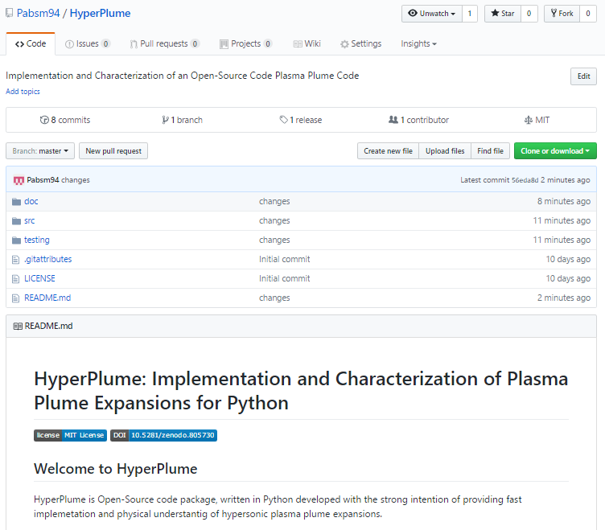
HYPERPLUME PYTHON CODE
Hyperplume Python package released in GitHub Repository.
What is GitHub: web hub for repositories, where all the contents of a particular project are safely stored and versioned.
Code released publicly to academic a non-scholar community. Protect authorship with license and DOI.
https://github.com/Pabsm94/HyperPlume
HYPERPLUME MAIN GITHUB REPOSITORY PAGE

Slide 15
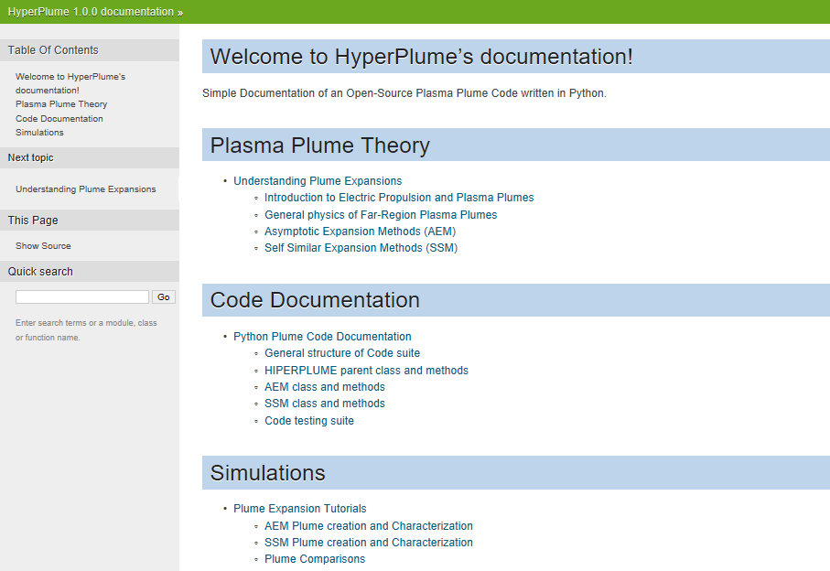
HYPERPLUME PYTHON CODE
Python additional tools allow quick documentation of the code. Sphinx adds value to the documentation. More interactive and readable. Multiple documentation output formats: PDF, HTML, etc.
HYPERPLUME HTML DOCUMENTATION LAYOUT. CREATED WITH SPHINX TOOL.

Slide 16
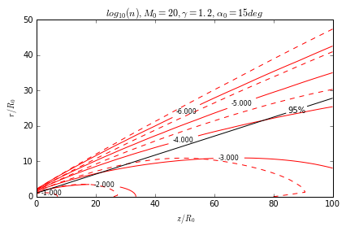
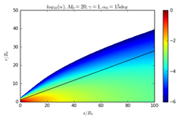
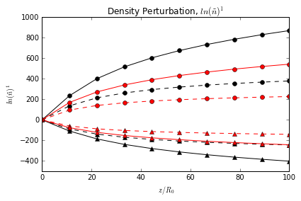
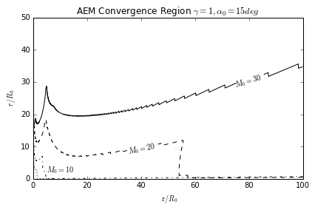
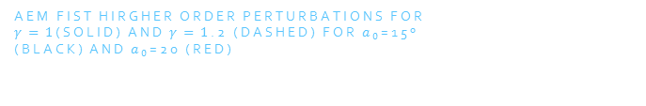

CHARACTERIZATION OF PLUMES WITH HYPERPLUME
AEM results: Influence of γ, $a_{0}$ and $M_{0}$ in plume variables and convergence region.
Findings:
AEM higher order corrections diverge radially and axially downstream.
Accuracy increases with larger $a_{0}$ and γ .
Convergence region of the model and accuracy increase with higher $M_{0}$.
density contours (logarithmic values) For zeroth order (solid lines) and Second order (dashed lines)
density contours (logarithmic results)
for first order correction
Aem fist hirgher order perturbations for
$γ=1$(solid) and $γ=1$.2 (dashed) for $a_{0}$=15º
(black) and $a_{0}$=20 (red)
Aem convergence region of the model.

Slide 17
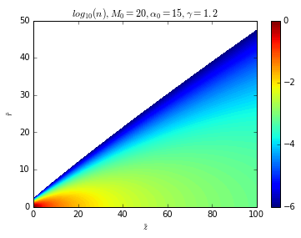
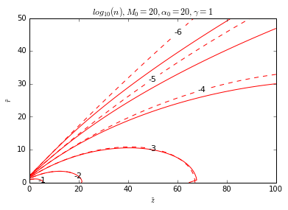
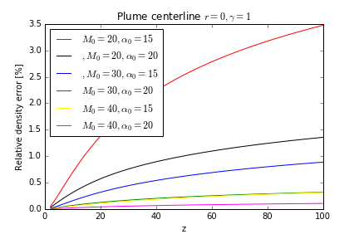
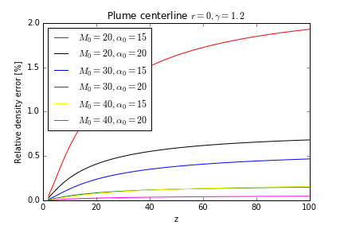

CHARACTERIZATION OF PLUMES WITH HYPERPLUME
Further accuracy gains are achieved with a AEM re-initialization approach:
Findings:
Greater accuracy of results especially downstream.
Difference between simple approach and marching scheme accentuates in critical plume expansion cases , when γ = 1 and low $α_{0}$.
Aem marching scheme density values
In second order
Comparison between simple and marching
Scheme aem for the second order.
Relative error between aem with and without marching scheme in the second order, for different $α_{0}$,$γ$ and $M_{0}$rw

Slide 18
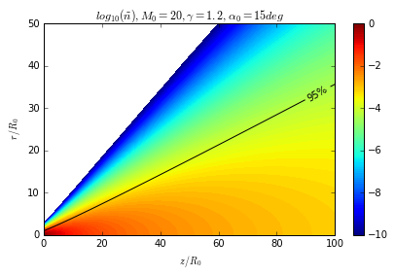
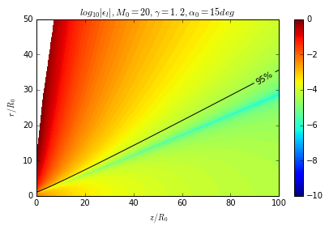
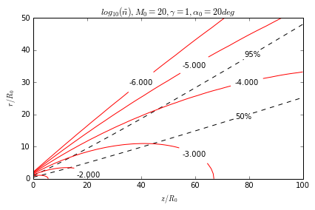
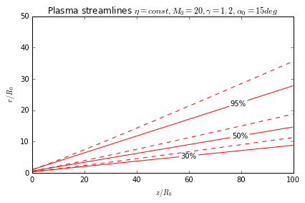


CHARACTERIZATION OF PLUMES WITH HYPERPLUME
SSM results: Influence of γ, $a_{0}$ and $M_{0}$ in plume variables
Findings:
More accurate results with increasing $M_{0}$.
$α_{0}$ and $γ$ influence SSM results slightly. Accuracy increases with lower divergence angle and higher $γ$.
Ssm density (logarithm) contours
Ssm residual error contours
SSM plume contours with 50% and 95%
ion streamline.
SSM eta lines (ion streamlines)

Slide 19
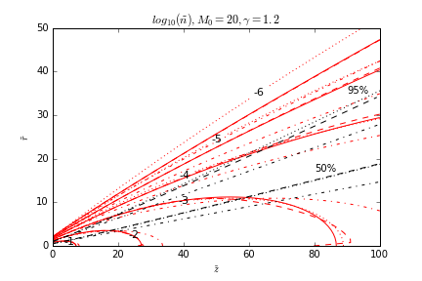
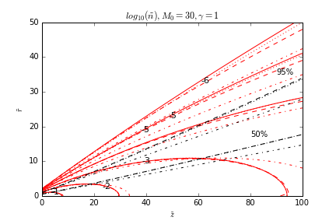
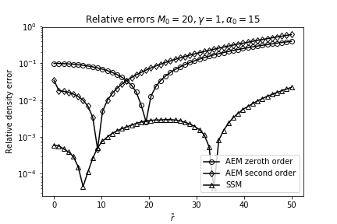
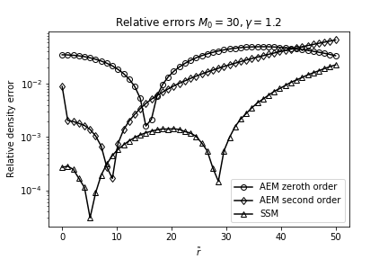

CHARACTERIZATION OF PLUMES WITH HYPERPLUME
Comparison between AEM (no re-initialization) and SSM plume:
Findings:
AEM better suited at short distances; SSM more accurate further downstream.
Both methods are comparable above $M_{0}≫25,30$.
SSM results are more accurate along plume axis, regardless of $M_{0}$.
AEM higher order corrections fall out of the convergence zone at ample radius values from plume centerline.
Density contours for different combinations of $M_{0}$ and $γ$.
Relative errors with respect to the AEM marching scheme solution in density, for different combinations of $M_{0}$ and $γ$.

Slide 20
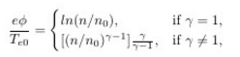
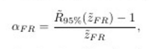

CHARACTERIZATION OF PLUMES WITH HYPERPLUME
Important parameters in the characterization of plume expansions: Ambipolar electric potential $\tilde{φ}$, and Far-Field divergence angle $α_{FR}$.
$\tilde{φ}$ is the mechanism responsible for ion radial acceleration and plume divergence rise.
$\tilde{φ}$ defined as:
$α_{FR}$ is important at design and operation procedure stages: avoid sputtering, rapid estimation of the momentum transferred to a surface downstream (IBS),etc
Assumptions
Ambipolar electric potential formula for isothermal
(Boltzmann relationship) and polytropic expansions.
Far-field divergence angle equation.
$R_{95\%}$ is the radius containing the 95%
Of the ion current at a distance $z$.

Slide 21
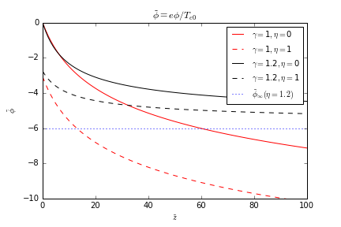

CHARACTERIZATION OF PLUMES WITH HYPERPLUME
Isothermal limit plume expansion yields the unphysical behavior $\tilde{φ}$ -∞ when $\tilde{n}$ 0.
Due to Boltzmann relationship.
On the other hand, if plasma cools down polytropically at a rate $γ>1$, ${\tilde{φ}}_{∞}=−\frac{γ}{γ−1}$
Isothermal and polytropic models diverge after $\tilde{z}=10$
Ambipolar electric potential at $η=0, η=1$ for
Different values of $γ$.

Slide 22
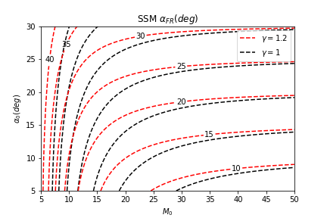

CHARACTERIZATION OF PLUMES WITH HYPERPLUME
Electron pressure becomes negligible and $α_{FR}$ asymptotically approaches $α_{0}$for large values of Mach number $\left(M_{0}>35\right)$.
$α_{FR}$ depends strongly on $M_{0}$ at moderate values ($M_{0}<25)$.
More effective: increase $M_{0}$ rather than reducing $α_{0}$
At any given $M_{0}$ and $α_{0}$, $α_{FR}$ is higher for lower $γ$ values, the electron pressure decaying more slowly closer to the isothermal limit.
$α_{0}$ sets a lower boundary to $α_{FR}$ in the range $[0,{\tilde{z}}_{F}]$
fAr-region divergence angle as a function of $M_{0}$ and
Different values of $γ$.

Slide 23

CONCLUSIONS
Investigation of plume expansions is fundamental in the electrical propulsion field. Accessible, fast and simple plume expansion knowledge is needed and beneficial.
Physics of plume expansions can be computationally modeled in Open-Source code. Python proven to be a powerful programming language for academic research.
HyperPlume Open-Source Python tool benefited from OOP and TDD approaches that increase code readability and integrity ,as well as user interaction. HyperPlume offers free access and quick yet accurate results on plume expansion processes.
SSM and AEM Semi-analytical methods developed in HyperPlume are accurate for expansions with $M_{0}≫1.$ Comparison of HyperPlume results against previous far-region plume expansion academic codes shows congruent results.

Slide 24
REFERENCES
George P. Sutton, Oscar Blibarz, Rocket Propulsion Elements,8th edition. Wiley, John Wiley & Sons, Inc,2010.
F. Cichocki ,M.Merino, E.Ahedo, Modeling and Simulation of EP Plasma Plume Expansion into Vacuum at Propulsion and Energy Forum, American Institute of Aeronautics and Astronautic, 50th AIAA/ASME/SAE/ASEE Joint Propulsion Conference, 2014.
F. Cichocki, M.Merino,E.Ahedo, A collisionless plasma thruster plume expansion model. Plasma Sources Science and Technology, IOP Publishing, 2015.
S. H. Lam, MAE 558 Plasmadynamics Notes Department of Mechanical and Aerospace Engineering Princeton University,March 12, 1997
E.J. Hinch. Perturbation methods. Cambridge University Press, 199
Goebel D. and Katz I. 2008 Fundamentals of Electric Propulsion: Ion and Hall Thrusters (New York: Wiley)

